Slide 1
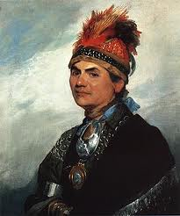
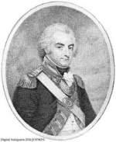
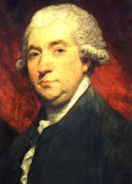
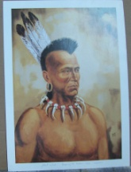
facebook
Wall
Photos
Joseph Brant
Logout
Joseph Brant
Wall
Info
Photos
Update status
Not feeling very hot today. >.<
Share
Wall
Info
Joseph Brant YAYYYYYY! I get to go back to England soon!
Jan. 1785 Like · Comment · See Friendship
Photos
Friends
James Hill Take me with you please!
Friends
Gilbert Tice I hope we have as much fun together as we did the first time.
Sir Guy Johnson
Joseph Brant About to raid Cherry Valley! I’m so nervous right now. : / I hope this isn’t my last battle!
Nov. 11 1778 Like · Comment · See Friendship
Joseph Brant Just finished attacking the colonial outposts on the New York Frontier. I AM VICTORIOUS!!!!!!!!!!
Aug. 7 1777 Like · Comment · See Friendship
James Boswell
Joseph Brant So sad : ‘ ( My trip to London is over.
May. 7 1776 Like · Comment · See Friendship
John Hill

Slide 2
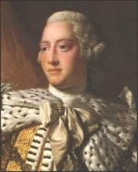
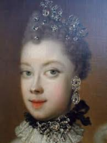
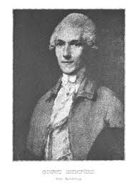
facebook
Wall
Photos
Joseph Brant
Logout
Joseph Brant
Joseph Brant I think I really impressed Mr. Boswell yesterday!
Apr. 3 1776 Like · Comment · See Friendship
James Boswell Yes you did sir!
Friends
Joseph Brant Big interview with London Magazine’s own James Boswell!
Apr. 2 1776 Like · Comment · See Friendship
King George III
Molly Brant You’ll do great big brother!
Queen Charlotte
John Hill Good Luck!
Gilbert Tice
Joseph Brant I loved exploring London with my good friend John Hill. Thank you Gilbert for showing us around.
Mar. 19 1776Like · Comment · See Friendship
John Hill I hope we get a chance to go back.
Gilbert Tice You’re welcome my friend.

Slide 3
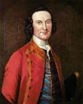
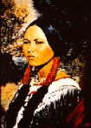
facebook
Wall
Photos
Joseph Brant
Logout
Joseph Brant
Joseph Brant Big day today, I have to present the tasks my tribe sent me to do to the leaders in London. Wish me luck!
Mar. 14 1776 Like · Comment · See Friendship
John Hill You are the best leader we could possibly have.
Friends
Sir William Johnson
Joseph Brant I’m kicking it at St. James’s Palace. What a great meal! Thanks to King George and his wife Queen Charlotte.
Feb. 29 1776Like · Comment · See Friendship
King George I was very impressed. For a Native American you are very proper and well mannered.
Molly Brant
Queen Charlotte Compliments to the chef for the meal, lord knows I don’t cook! LOL
Joseph Brant Graduation! Finally graduated from Lebanon High School in Connecticut.
1763 Like · Comment · See Friendship
Joseph Brant Wish me luck I’m going to my first war following Sir William Johnson.
June 1606 Like · Comment · See Friendship
Sir William Johnson Thank you for believing in me young man.

Slide 4
facebook
Wall
Photos
Joseph Brant
Logout
Joseph Brant
Wall
Info
Photos
Information
Current City: Lebanon, Connecticut
Hometown: Ohio River Valley, United States
Sex: Male
Birthday: 1742
Relationship Status: Married
Employer: Self Employed
Education: Eleazer Wheelcock Academy
Religion: Anglican
Political Views: Give Indians More Land
People Who Inspire: Sir William Johnson For Being Brave in Leading an Army
Favorite Quotations: “Indeed it is very hard, when we have let the king’s subjects have
so much of our lands for so little.”
Favorite Books: Gospel of Mark and The Prayer Book
Activities: Leading An Army and Spreading Christianity Throughout Native
American Lands
Wall
Info
Photos
Friends
Contact Information
Address: 301 Mohawk Street Brantford, Ontario, Canada

Slide 5
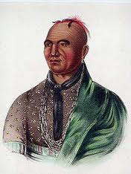
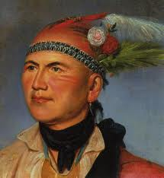
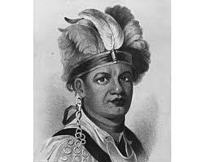
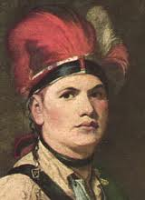
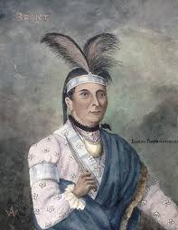
facebook
Wall
Photos
Joseph Brant
Logout
Joseph Brant
Wall
Info
Photos
Photos of Joseph 6 Photos

