Slide 1
Tragic Love
An Introduction to
Romeo and Juliet

Slide 2
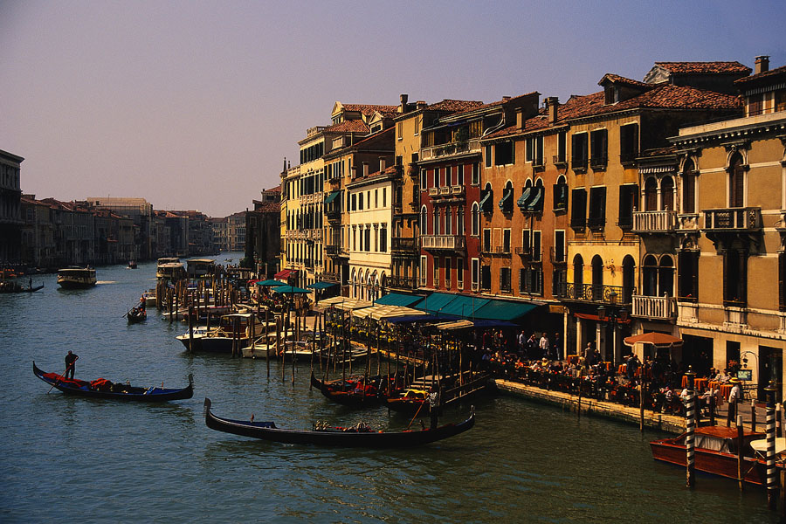
Romeo and Juliet
Setting
Verona, Italy
Late 1500s

Slide 3
Characters: The Capulets
Juliet Capulet
Lord and Lady Capulet
Count Paris
Tybalt
Nurse
Notes:
Juliet Capulet – a 13-year-old girl
Lord and Lady Capulet – Juliet’s parents
Count Paris – the man Juliet’s father wants her to marry
Tybalt – Juliet’s cousin.
Nurse – Juliet’s nurse, who has taken care of her since she was a baby

Slide 4
Characters: The Montagues
Romeo Montague
Lord and Lady Montague
Benvolio Montague
Mercutio
Friar Laurence
Notes:
Romeo Montague: A young man, probably about 17 years old
Lord and Lady Montague: Romeo’s parents
Benvolio Montague: Romeo’s cousin
Mercutio: Romeo’s best friend
Friar Laurence: A priest and friend of Romeo

Slide 5
Part I:
Romeo and Juliet: Summary
A family feud
Falling in love
A secret marriage
Notes:
A family feud:
The story takes place in Verona, Italy, in the late 1500s. The Montagues and the Capulets, two very powerful families, have been fighting for many years.
The Capulets throw a big party.
Romeo Montague wants to go to the party to see Rosaline, a girl he likes. Because of the feud, his family is not invited. He wears a costume and sneaks into the party anyway.
Falling in love:
At the party, Romeo sees a girl, Juliet, and falls in love. Soon he finds out that she is a Capulet.
Juliet sees Romeo and falls in love with him, too. She has no idea that he is a member of the Montague family.
Later, Juliet learns that Romeo is a Montague. She goes out on her balcony to talk to the stars about her love for Romeo.
Romeo hears her and tells her he feels the same.
A secret marriage:
The next day Romeo and Juliet are married secretly by Romeo’s friend Friar Lawrence. They tell no one.

Slide 6
Romeo and Juliet: Summary
A fight
A banishment
A match-making father
Notes:
A fight:
The same day that Romeo and Juliet are married, Romeo's cousin Benvolio and his best friend, Mercutio, get into a fight with Juliet’s cousin Tybalt.
Tybalt is mad at Romeo for coming to the Capulets’ party, so he starts a fight with Benvolio and Mercutio.
Romeo shows up. He does not want to fight Tybalt because he is married to Juliet, but he cannot tell anyone.
Romeo’s friends don’t understand why Romeo won’t fight, so Mercutio fights Tybalt instead. Tybalt kills Mercutio.
Romeo is angry and kills Tybalt.
A banishment:
The Prince of Verona tells Romeo that he must leave the city forever and never come back.
Juliet is very sad because Romeo is gone.
A Match-making father:
Juliet's father, who doesn’t know that Juliet is already married to Romeo, decides to marry her to a man named Paris.

Slide 7
Romeo and Juliet: Summary
A desperate plan
Some deadly gossip
The death of Romeo and Juliet
A lesson learned
Notes:
A desperate plan:
Juliet goes to Friar Lawrence for help.
He gives her a potion to drink that will make her look dead, even though she really will just be sleeping.
The Friar says he will tell Romeo to come get her from the family tomb.
Some deadly gossip:
Before the Friar can tell Romeo that Juliet is not really dead, Romeo gets a message from a friend that Juliet is dead in Verona.
Romeo wants to die beside his wife, so he buys poison and goes to Juliet's tomb.
At the door of the tomb, Romeo fights and kills Paris.
The death of Romeo and Juliet:
Inside the tomb, Romeo drinks the poison and dies next to Juliet.
Soon after, Juliet wakes up and sees Romeo dead next to her.
Friar Lawrence comes into the tomb and tells Juliet what happened.
Juliet takes Romeo’s dagger and kills herself.
A lesson learned:
The Montagues and Capulets learn a lesson from the deaths of their children. They agree to never fight again.

Slide 8

Romeo and Juliet Today
Why do we read Romeo and Juliet today?
How does the story connect to the lives of teenagers today?

Slide 9
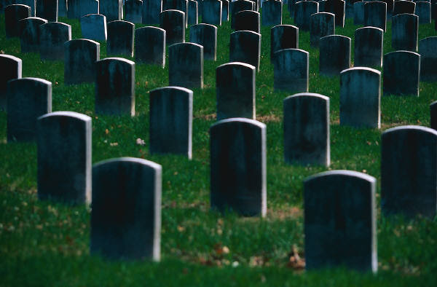
Part II:
TRAGEDY
Romeo and Juliet is a tragedy.
Notes:
Definition of tragedy: a dramatic work that has a serious or sad theme. It has a character that has many problems or weaknesses. A tragedy usually ends with the deaths of the main characters.

Slide 10
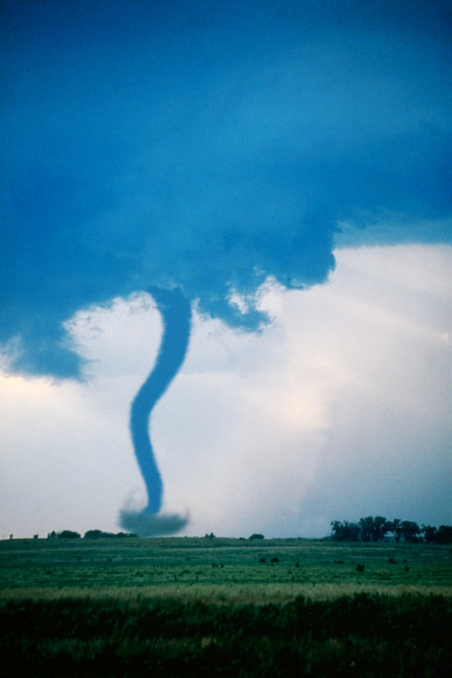
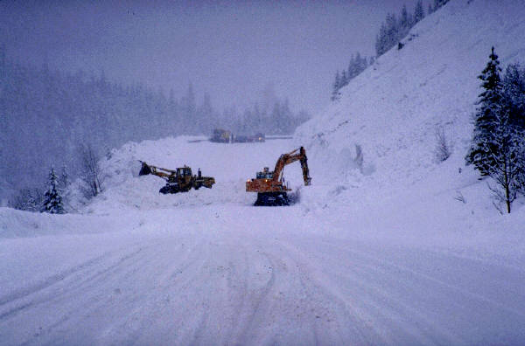
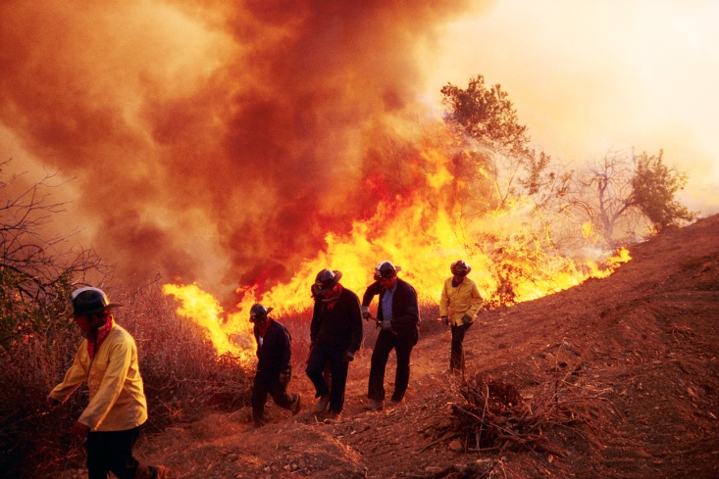
Examples of tragedy:

Slide 11
Thinking about Tragedy
What T.V. shows, movies, or books show tragedy?
How does tragedy affect people’s lives?

Slide 12
Tragic Love?
Romeo and Juliet is considered a “tragic love story.”
What is tragic love?
How does tragic love affect teenagers today?

