Slide 1

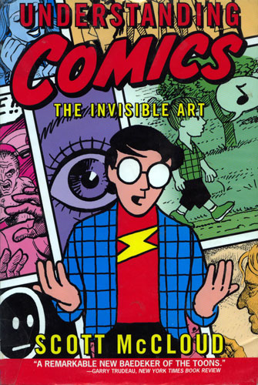
AIM: To understand what the comics medium is and how it works as it relates to the Great Immigrants, Great Americans series and other comics texts.
Notes:
Created by Scott Honig

Slide 2
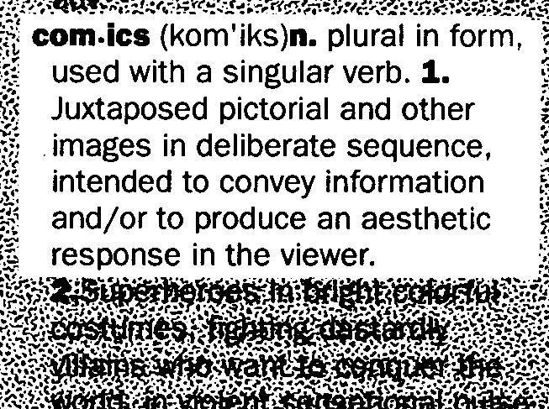
Part I: Comics Terminology
(McCloud, 9)
Notes:
Lead students through a process of defining comics. McCloud’s book offers first attempts at a definition, which teachers can use to gradually arrive at this complete definition.

Slide 3
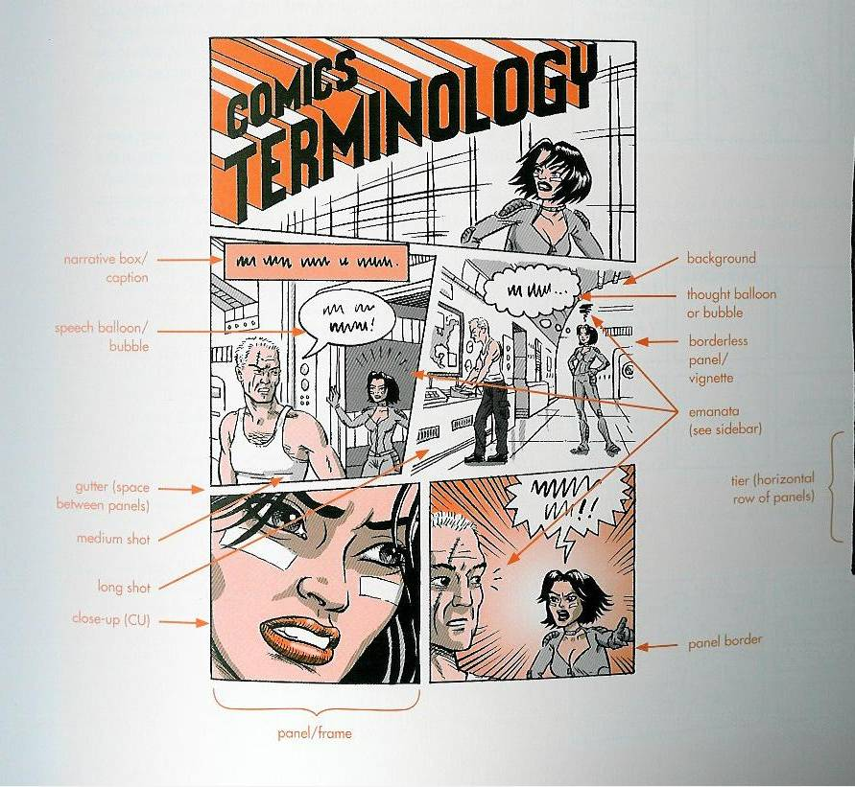
(Abel & Madden, 7)
Notes:
Recommended terms include panel, grid, gutter, and additional terms as needed/appropriate. For a complete list of applicable terms, see the unit lesson plan on Resource 4.

Slide 4
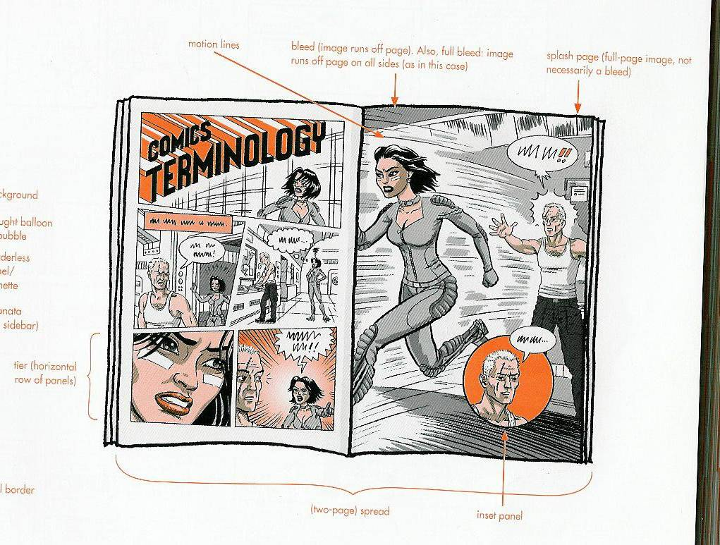
(Abel & Madden, 7)

Slide 5
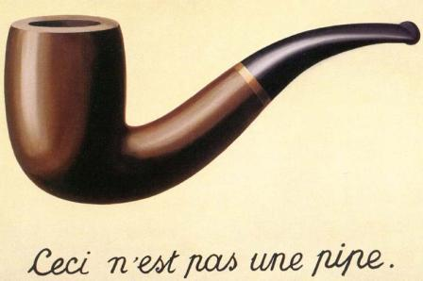
Part II: Iconography–The Language of Comics
(Magritte, 1929)
Notes:
Rene Magritte created this painting, entitled “The Treachery of Images,” to illustrate that visual art necessarily deceives its viewers. The “treachery” here is that, while the viewer believes he/she is looking at a pipe, this is merely a representation of a pipe. Or, more accurately for this slideshow, a light projection of a digital image of a reproduction of a painting of a pipe. Thus, the French phrase on the painting translate to: “This is not a pipe.” This is a theoretical foundation for this resource as well.

Slide 6
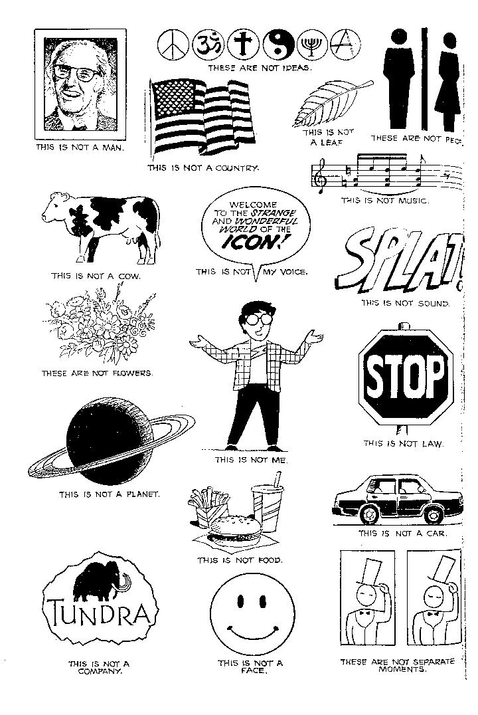
(McCloud, 26)
Notes:
Using Magritte’s example on the previous slide, students can generalize the objects represented on this slide.

Slide 7
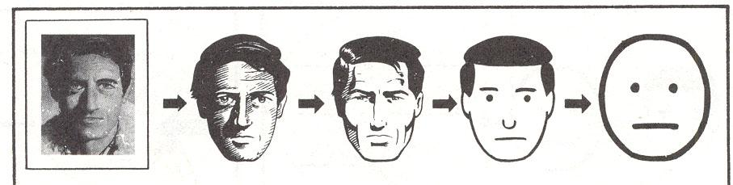
How many people in the world are
represented by each image below?
(McCloud, 29)
Notes:
Image 1: 1 person; Image 2: several million people; Image 3: maybe 1 billion people; Image 4: several billion people; Image 5: nearly everyone
Thus, this chart demonstrates what McCloud calls “amplification through simplification” (30). A cartoon works precisely because it simplifies a real object’s form down to as few lines as possible to be as universally understood as possible.

Slide 8
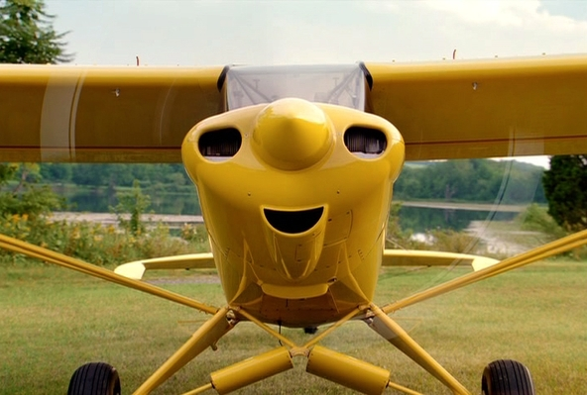


What are you really seeing?
Notes:
This phenomenon, by which human beings tend to see their own faces in objects that merely suggest a face, is called pareidolia.

Slide 9
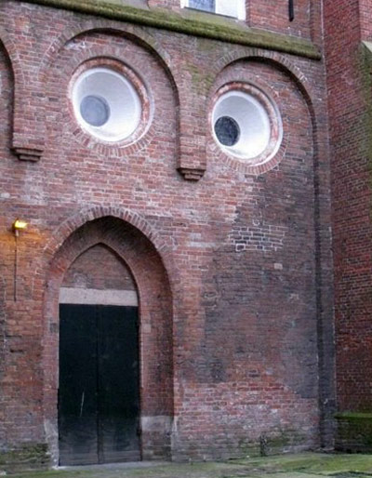
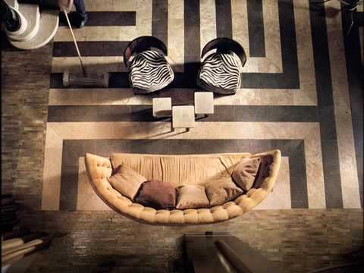
What are you really seeing?

Slide 10
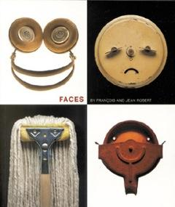
What are you
really seeing?

Slide 11
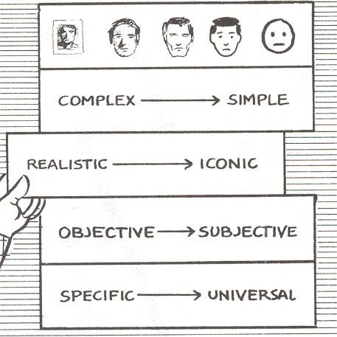
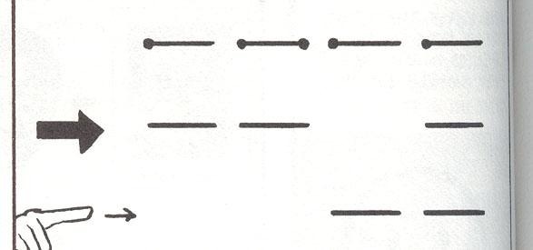
(McCloud, 46)
Notes:
In the image on the right, students can draw the lines from each dot at the top down to the finger at the bottom. The result should be the word “face” in all capital letters. This marks where the chart crosses over from received information (the immediately understood images of a face) to perceived information (text that must used the specialized skill of reading to understand) (McCloud, 49).

Slide 12
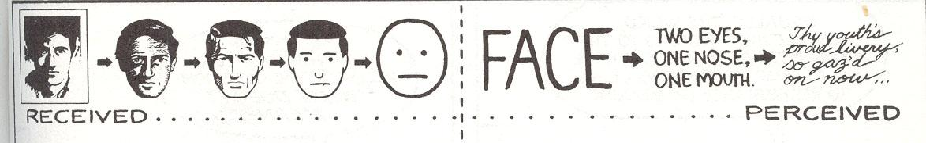
(McCloud, 49)
Notes:
While the faces on the left side of the chart grow more universal as they move toward the center, the text on the right side of the chart grows more specific and difficult to decipher as it continues. By the time a viewer reaches the final item on the chart, they not only must be able to read in English, but they must also be able to read in English script, and they must also be able to comprehend semi-Shakespearean language.

Slide 13
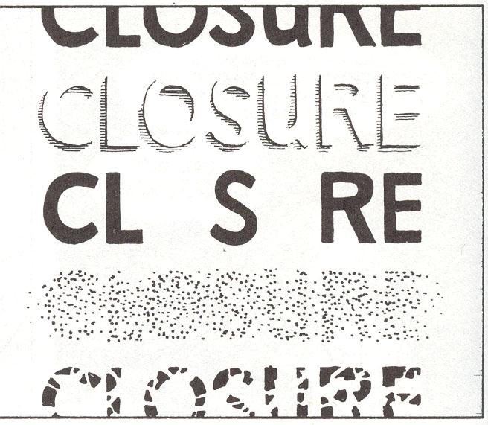
Part III: Closure–The Grammar of Comics
(McCloud, 64)
Notes:
Students will be surprised when shown that they are capable of reading the word even when certain parts of the lettering are missing and/or obscured. This is precisely how closure works.

Slide 14
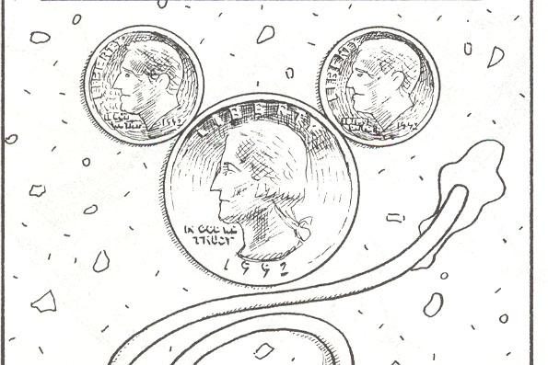
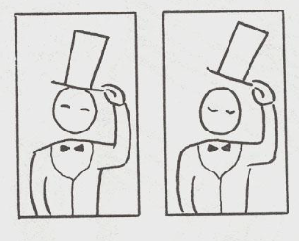
What do you most closely
associate with this image?
What is “happening”
in these panels?
(McCloud, 64)
(McCloud, 65)
Notes:
Most students will likely say “Mickey Mouse” in response to the first image. This is a great time to mention other cartoon characters who are immediately recognizable by their silhouettes because they are essentially geometric shapes with eyes. More contemporary cartoon characters like Spongebob Squarepants and his best friend Patrick Star work very well for this discussion. The image on the right presents an opportunity to introduce students to the gutter, the empty space running between the panels on a comics page. It is in that blank space that readers commit closure; in other words, they use the clues presented inside the panels to draw inferences about what is happening in between to create the illusion of movement.

Slide 15
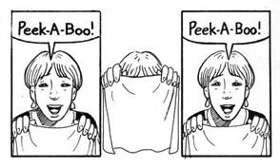
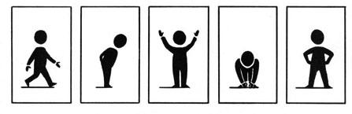
(McCloud, 67)
(McCloud, 67)
Notes:
Ask students what they think is happening in each panel sequence and how they know. Further examples of closure at work in the gutters between the panels.

Slide 16
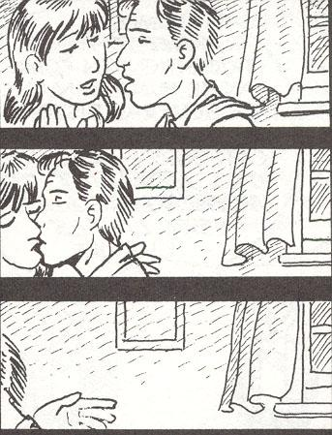
(McCloud, 69)

Slide 17
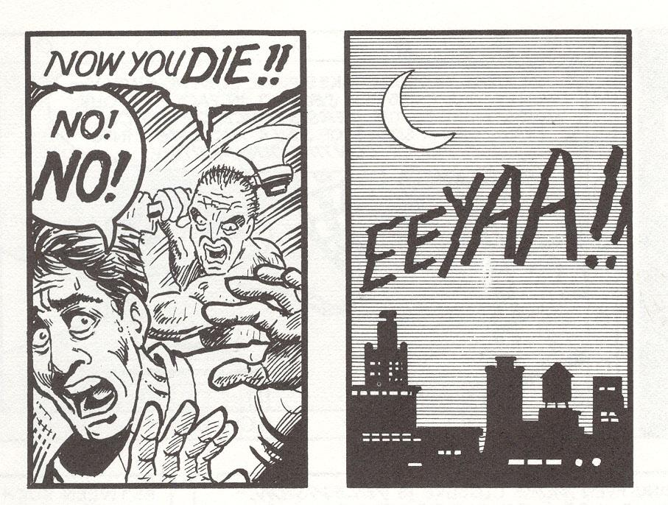
(McCloud, 68)
Notes:
The students will be surprised to find out that the murderer in this sequence is…them! Since the actual axe strike is never shown on panel, any violence perpetrated occurs inside the reader’s mind.

Slide 18
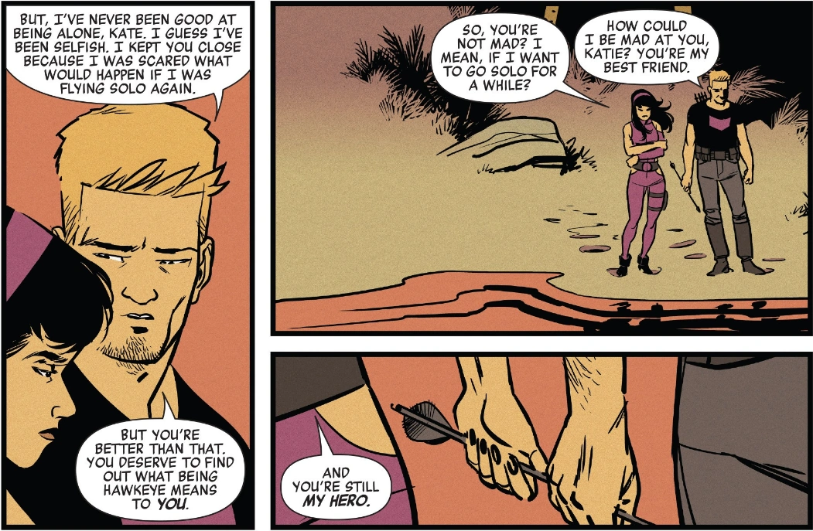
Part IV: Visual Techniques of Comics
Panel Shots
(Think zooming in and out)
Close-Up: Tightly frames a person or an object. Little of the person or object is revealed but usually used to emphasize detail.
Scene/background almost non-existent.
(Fraction and Aja)
Notes:
These slides can be linked to film studies and the ways authors create images through written text. They contain terms and definitions for ways of seeing/presenting information through panels and pages.

Slide 19
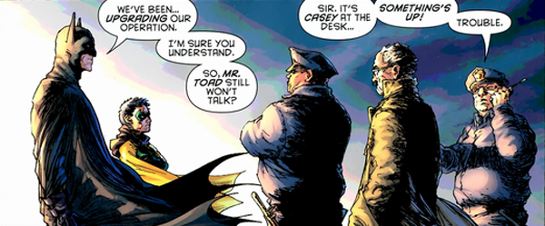
Medium Shot: Falls between a close-up and a long distance shot. You can almost see all of an object or person.
Some hints of a scene/ background or none at all.
(Morrison and Quitely)

Slide 20
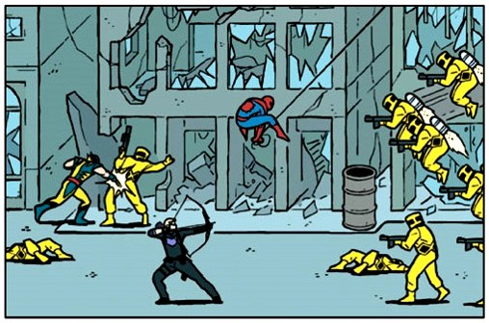
Long Shot: Typically shows the entire object or human figure and its surroundings.
Scene/background is obvious.
(Fraction and Aja)

Slide 21
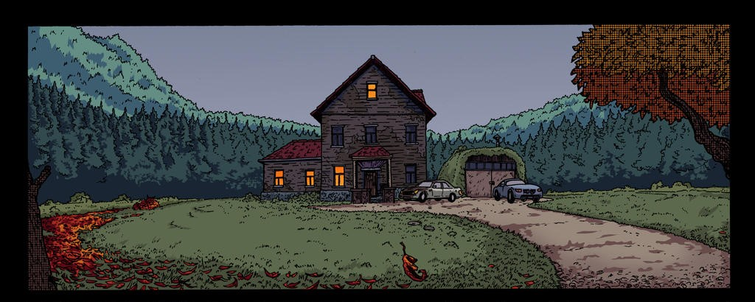
Establishing Shot
(MxDagger)

Slide 22
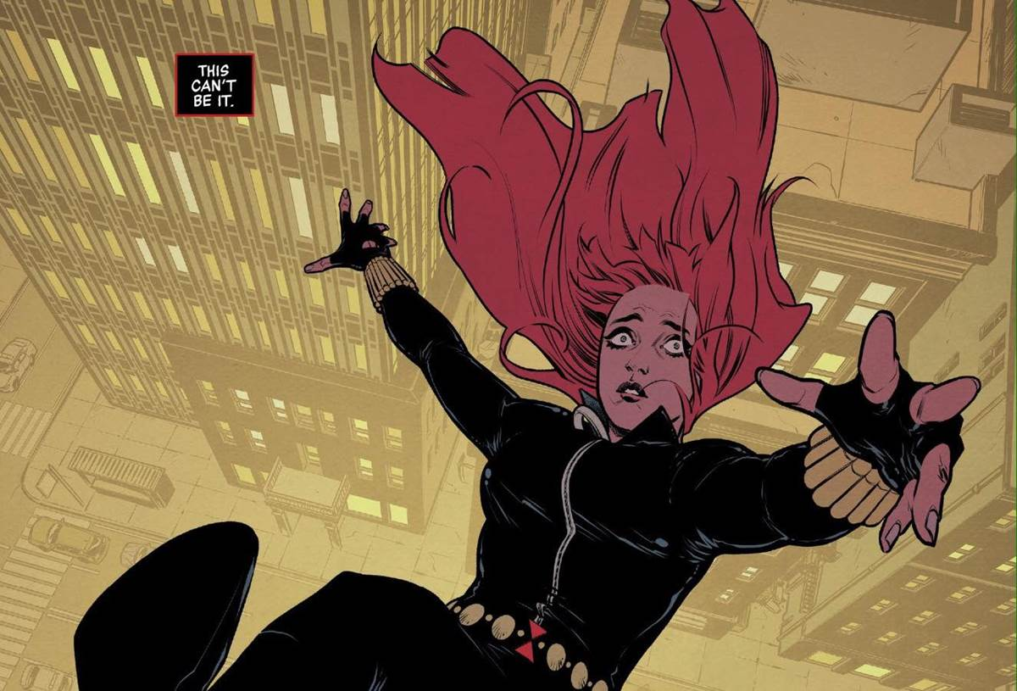
Panel Angles
(Think: “Where’s the ‘camera’?”)
High Angle or Bird’s-Eye View: A high angle shot, looking down on a scene.
(Thompson and Casagrande)

Slide 23
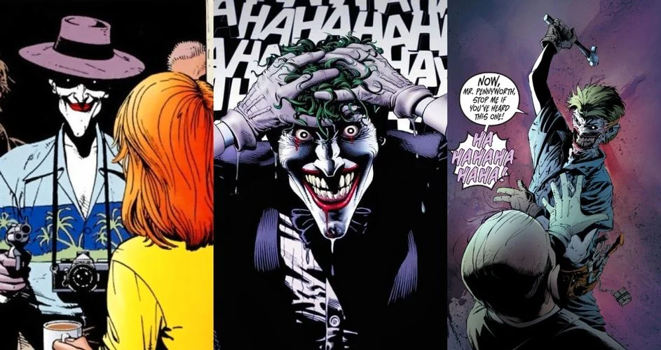
Eye-Level View: A straight-on angle of a scene, as if you were standing directly in front of the moment.
(Moore and Bolland)

Slide 24
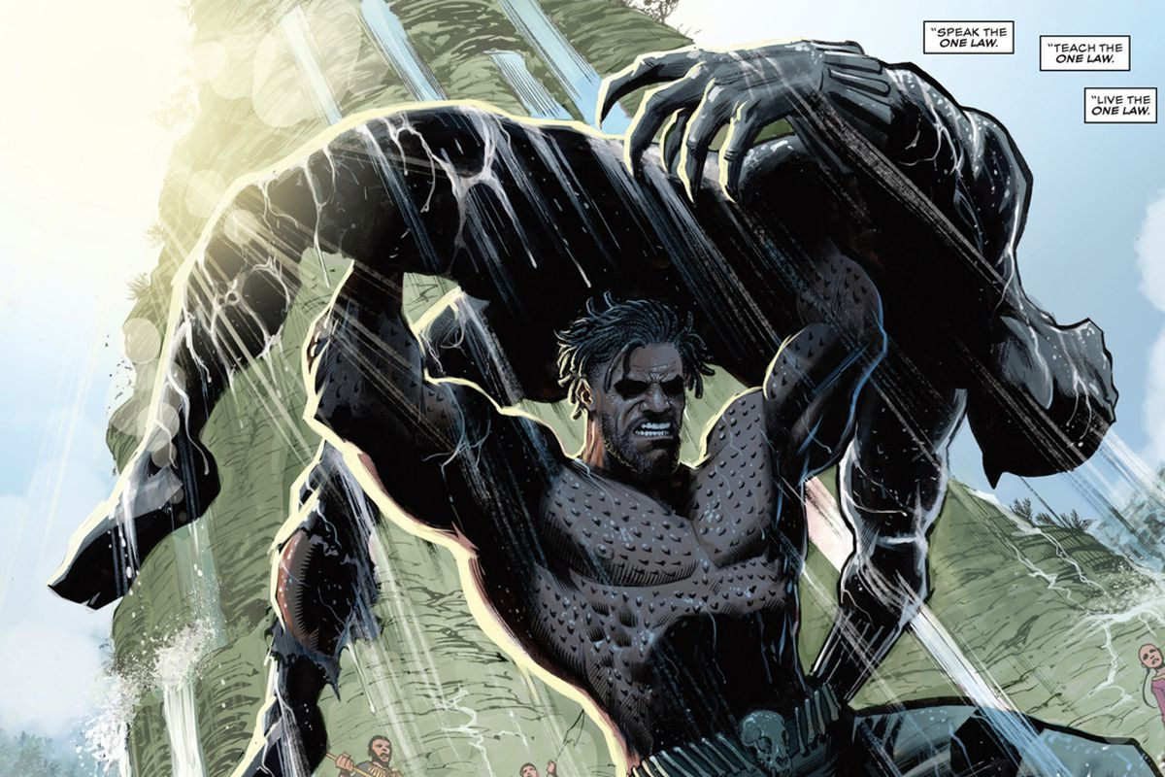
Low Angle or Worm’s-Eye View: A low angle shot, as if you were on the floor looking up.
(Hill and Ferreyra)

Slide 25
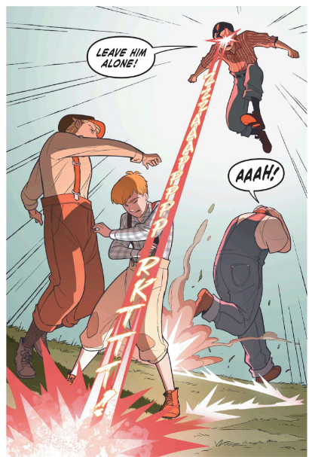
What’s the shot?
Close
Medium
Long
What’s the Angle?
Bird’s-eye view
Worm’s-eye view
Eye level
And the more important question: Why make these choices here?
(Yang and Gurihiru)

Slide 26
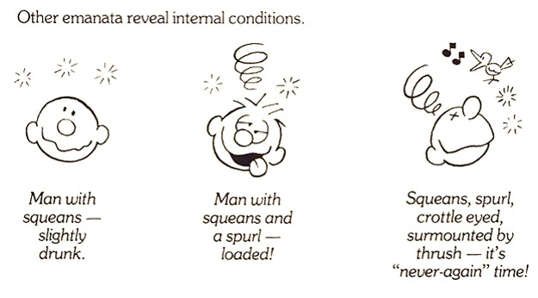
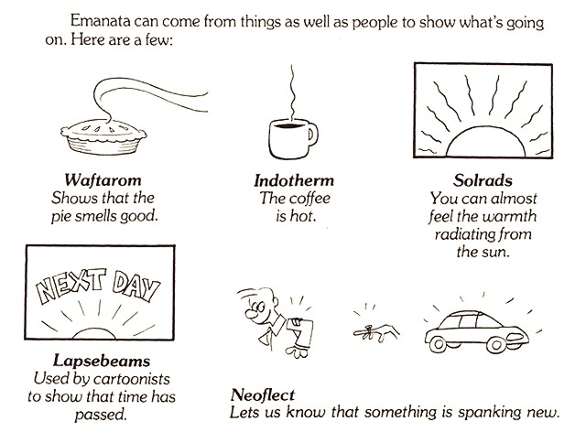
Emanata
(Walker)

Slide 27
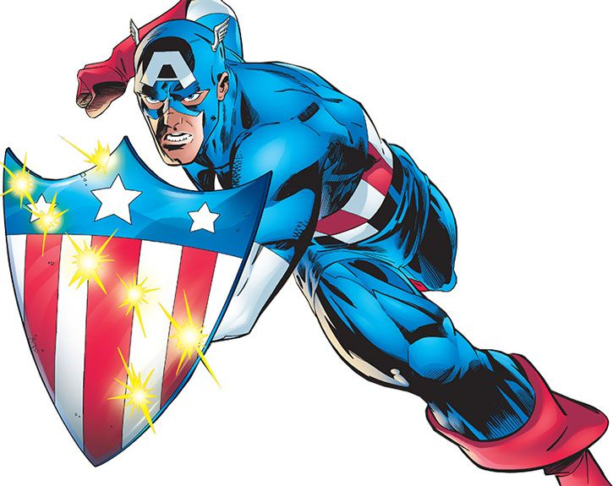
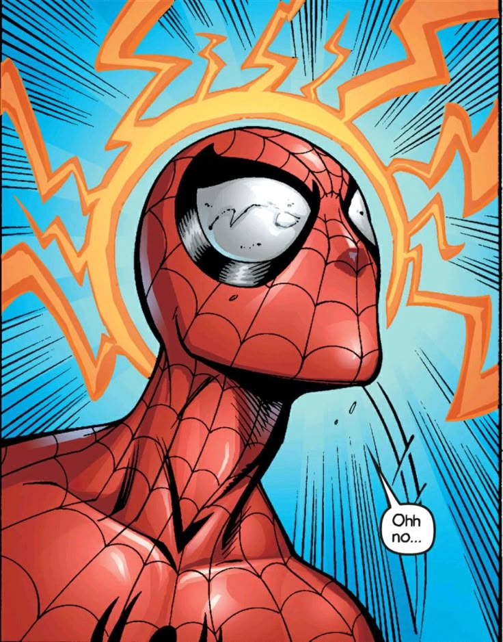
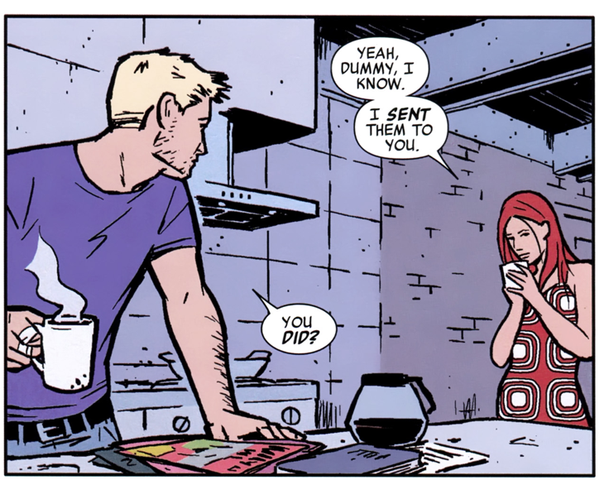
(Fraction and Aja)
(Waid and Garney)
(Bendis and Bagley)

Slide 28
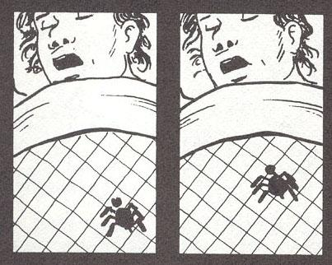
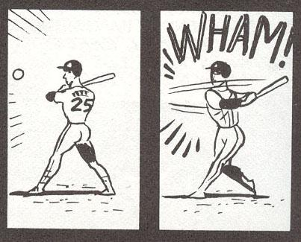
Panel-to-Panel Transitions
Moment-to-moment
Action-to-action
(McCloud, 70)

Slide 29
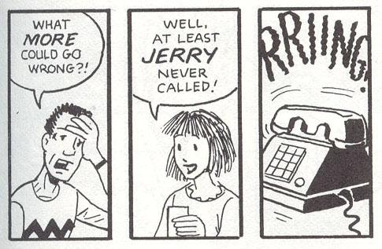
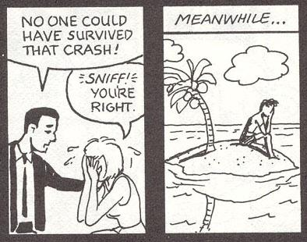
Subject-to-subject
Scene-to-scene
(McCloud, 71)

Slide 30
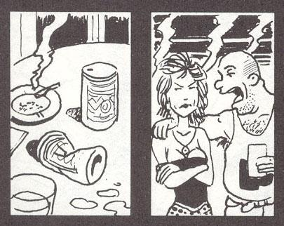
Aspect-to-aspect
(McCloud, 72)

Slide 31
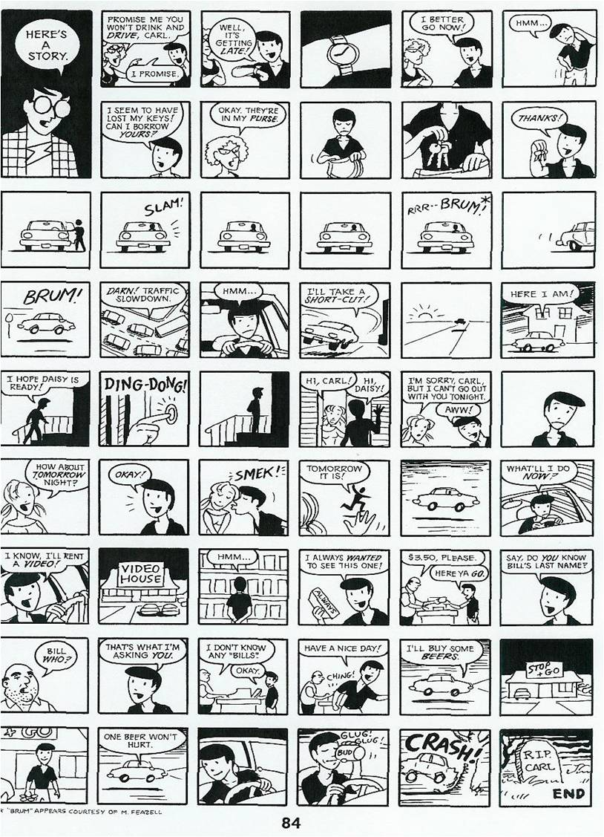
Part V: Putting It All Together
(McCloud, 84)
Notes:
This first story is misusing the comics medium by including too many irrelevant panels to move the action along. Most students, with a teacher’s guidance, can already begin to see which panels can be removed with no negative impact on the story.

Slide 32
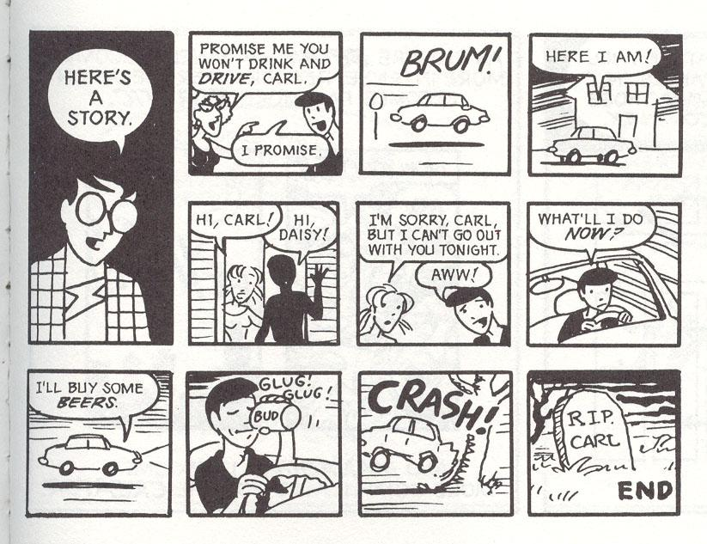
(McCloud, 85)
Notes:
This version of the same story is better, which is to say much more economical.

Slide 33
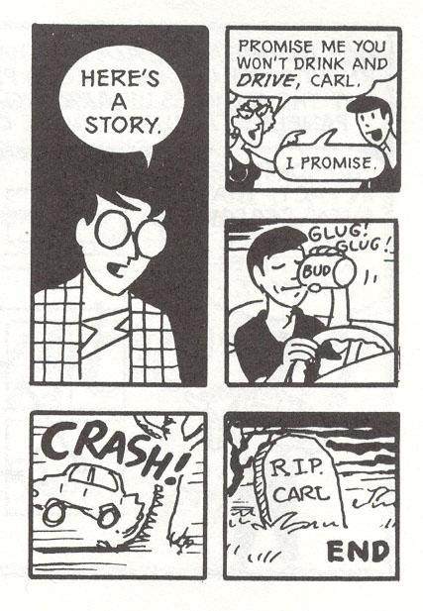
(McCloud, 85)
Notes:
This version is certainly more economical, but it starts to lose some of its humanity in failing to develop the characters or plot much at all.

Slide 34
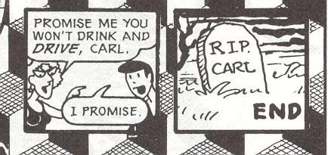
(McCloud, 85)
Notes:
This final version reads more like a PSA for the dangers of drunk driving than a proper story because it cuts out everything except for the theme.

Slide 35
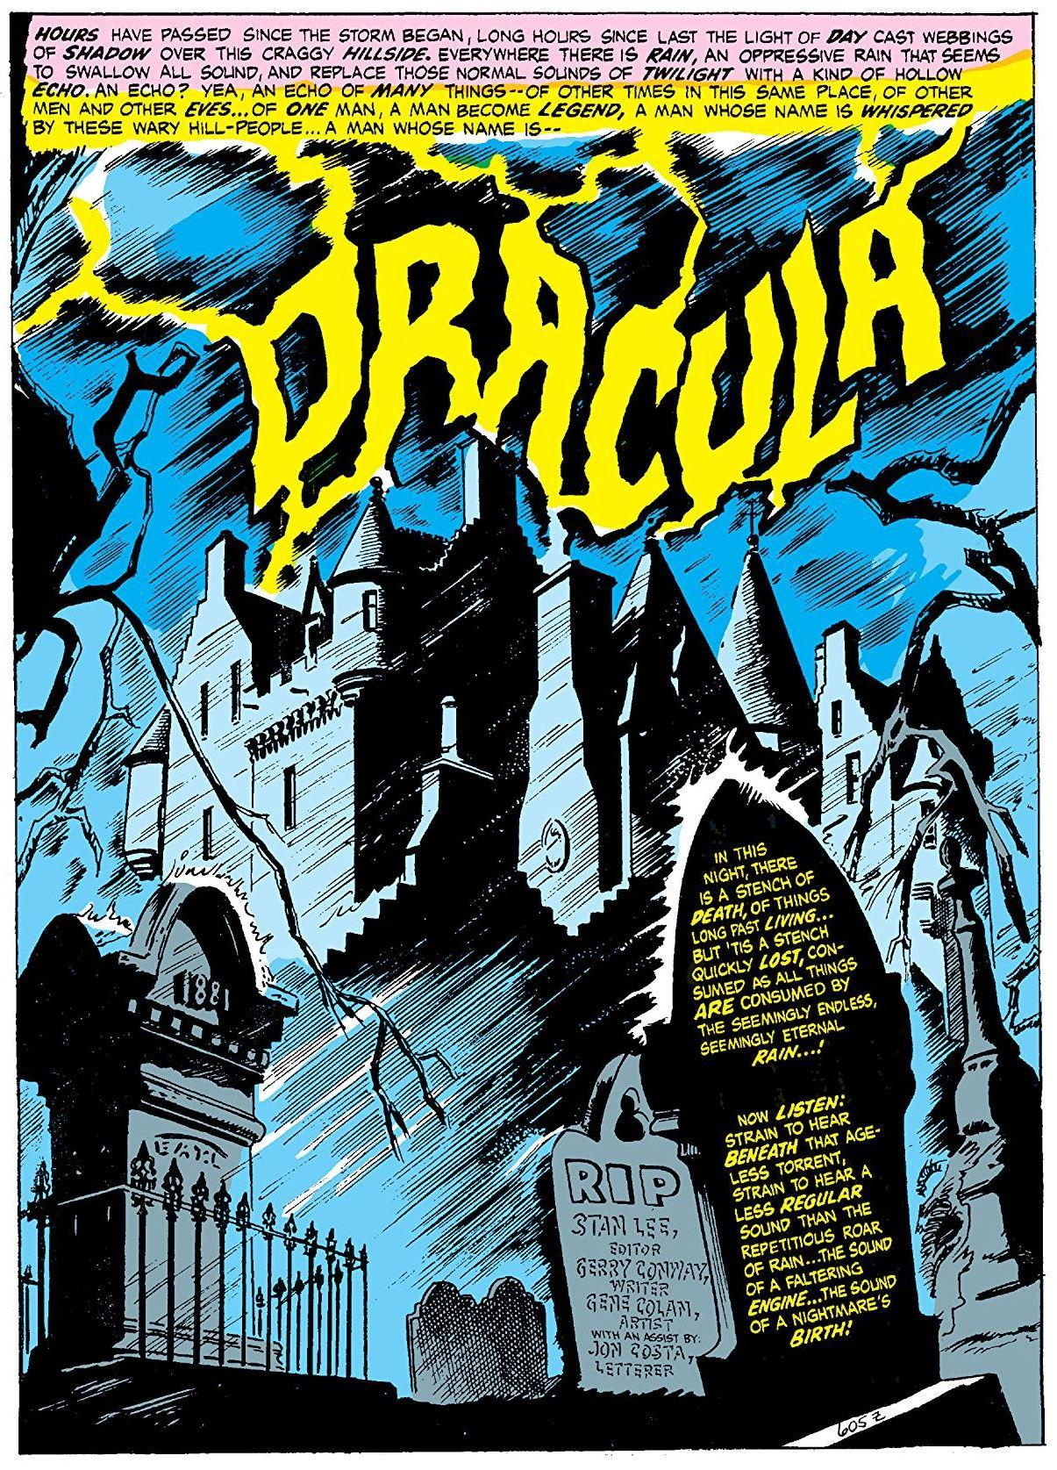
Paralleling Form and Content
What is the creators’ intent for the conceptual movement of the story?
What techniques do they use to achieve their goals?
Why are these the best choices given their intent?
(Conway and Colan, 1)
Notes:
This full-page spread is the opening splash page of the first issue of the horror series Tomb of Dracula (1972), written by Gerry Conway and illustrated by Gene Colan. At this point in mainstream comics, most monsters—werewolves, zombies, vampires—were forbidden by the Comics Code Authority, the rationale being that the inclusion of frightening images and graphic gore would be too tempting for most writers and artists to avoid. Marvel Comics skirted this restriction by positioning Bram Stoker’s original creation as the protagonist of his own series. Dracula, still a bloodsucking, gothic creature of the night, would now become sympathetic as he searches not just for ways to sate his hemo-hunger without murdering innocents but also for real human connection, possibly even love. The cognitive dissonance a potential reader would need to overcome in order to view such a famous literary and cinematic villain as a kind of hero is not insignificant, so the creators of the comic book address it immediately with the opening page. Here, the image appropriately establishes the setting, that of a gothic castle atop a craggy hill in eastern Europe. The lightning effect creates a contrast between the light and the dark, which suggests the duality of the character about to be introduced. It is, however, the rain that pelts the landscape that acts as the most significant visual element of the page. The linework that suggests the rain moves from the upper right-hand corner of the page to the lower left-hand corner of the page, forcing the reader’s eye to take in the page in that direction as well. However, the text elements of the page, the creator credits and the story’s opening narration, are presented in the lower right-hand corner of the page. This means that the reader’s eye must battle against the flow of the linework in order to begin reading the tale of one of pop culture’s greatest villains attempting to gain the sympathies of the audience. Conway and Colan, therefore, don’t just acknowledge the cognitive dissonance but embrace it, using the multimodality of the comics medium to their advantage in welcoming the readers to their story.

Slide 36
Works Cited
Abel, Jessica, and Matt Madden. Drawing Words & Writing Pictures. New York, First Second, 2008, p. 7.
Bendis, Brian Michael, and Mark Bagley. Ultimate Spider-Man: Power & Responsibility. New York, Marvel Comics, 2000.
Conway, Gerry, and Gene Colan. The Tomb of Dracula. Vol. 1, New York, Marvel Comics, 1972, p. 1.
Fraction, Matt, and David Aja. Hawkeye: My Life as a Weapon. New York, Marvel Comics, 2013.
Hill, Bryan, and Juan Ferreyra. Killmonger: By Any Means. New York, Marvel Comics, 2019.
Magritte, René. The Treachery of Images. 1929, Los Angeles County Museum of Art, Los Angeles.
McCloud, Scott. Understanding Comics: The Invisible Art. New York, HarperCollins, 1994, pp. 9-85.
Moore, Alan, and Brian Bolland. Batman: The Killing Joke. New York, DC Comics, 1988.
Morrison, Grant, and Frank Quitely. Batman & Robin: Batman Reborn. New York, DC Comics, 2010.
MxDagger. Environment/Establishing Shot Exercise. 2017, Deviant Art.
Thompson, Kelly, and Elena Casagrande. Black Widow: The Ties That Bind. New York, Marvel Comics, 2021.
Waid, Mark, and Ron Garney. Captain America: To Serve and Protect. New York, Marvel Comics, 2002.
Walker, Mort. Lexicon of Comicana. Penguin Random House, 2025.
Yang, Gene Luen, and Gurihiru. Superman Smashes the Klan. Burbank, DC Comics, 2019.

