Slide 1
Denotation, Positive Connotation, or Negative Connotation?
Directions: Read each headline. Determine if the word “immigrant” or the word “immigration” is being used for its denotation, for a positive connotation, or for a negative connotation. If you need more information, be prepared to discuss what information would help you make a decision.
Notes:
Anna Osborn - Teacher Notes: Depending on student skill and time, students could be sent to various databases to search for and find headlines.

Slide 2
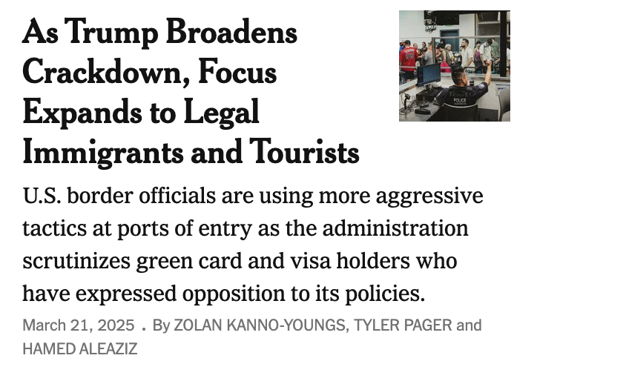
Notes:
Teacher Notes: Discuss the following vocabulary with students to ensure they know important vocabulary when discussing immigration:
Legal immigrants
Tourists
Border officials
Border
Port of entry
Green card
Visa
Add any additional terms you feel students would benefit from learning. Teachers might lead students in creating a glossary of immigration terms using the Alphabet Organizer tool from ReadWriteThink.

Slide 3
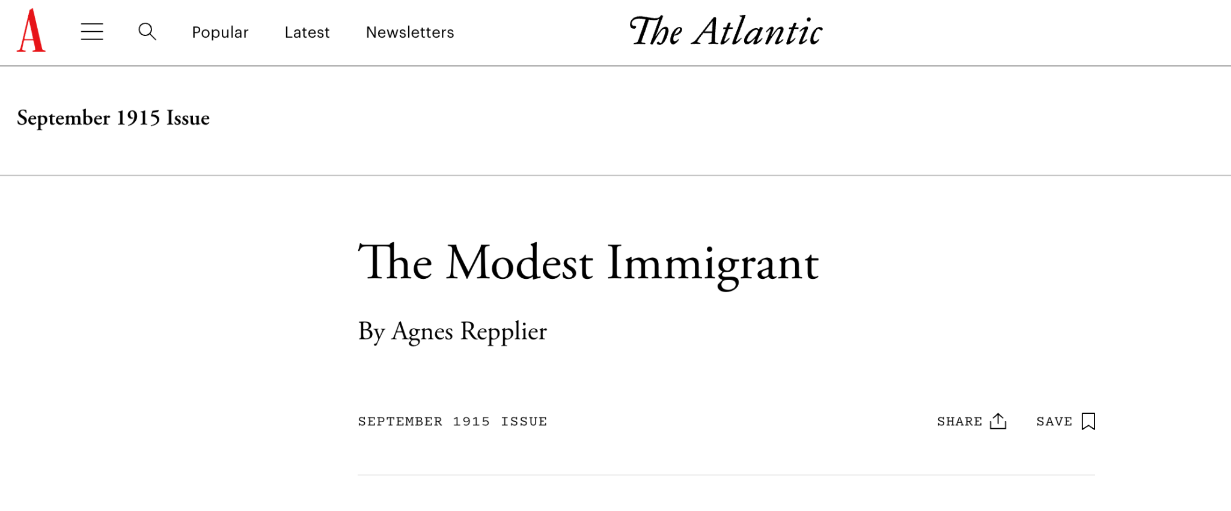
Notes:
Teacher Notes: Pair this headline with the 5:43 video How WWI Changed America: Immigrants and WWI from the National WWI Museum and Memorial. In light of the information shared in the video, what might this headline mean? Teachers may need to display a definition of “modest” for discussion.

Slide 4
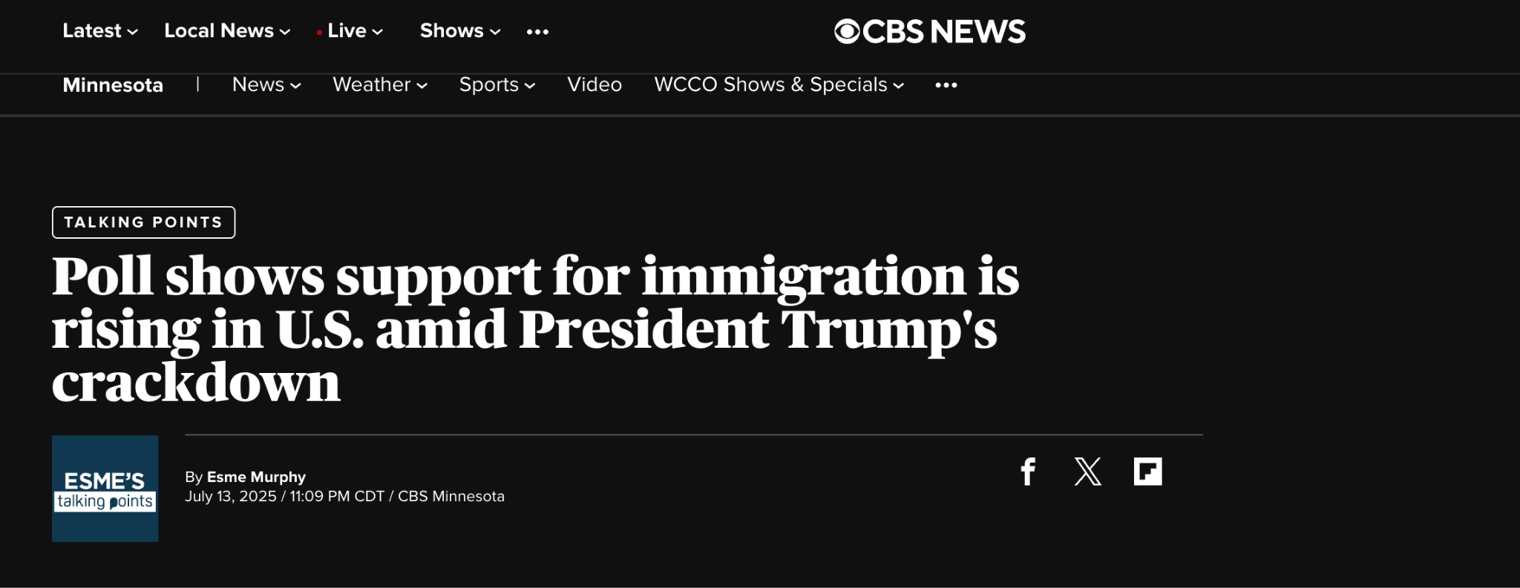
Notes:
Teacher Notes:Teachers might gather more recent headlines or collect headlines with students throughout their reading of Great Immigrants, Great Americans: The Comic Book that show how public opinion might be impacting connotation of the terms immigrant and immigration.
Consider having students share Great Immigrants, Great Americans: The Comic Book with school and local communities in a variety of ways. Some possibilities:
Encourage families to read the comics along with students. Host a celebration of immigration for families.
Bring in a guest speaker who might speak about immigration or share an immigration story.
Celebrate and highlight student immigrants in the class or school.
Have students create one pagers about individuals featured in the comics or choose a graphic organizer from one of ReadWriteThink’s Printouts page that might help students organize thoughts as they read and display student work in a public area in the building.

Slide 5
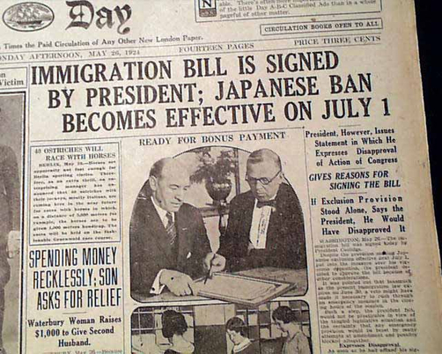
Notes:
Teacher Notes: Teachers can read Jeff Jacoby’s opinion piece from which this newspaper image is borrowed for background information. Additional context can be gotten from the following resources:
The Immigration Act of 1924 (The Johnson-Reed Act) (Office of the Historian, Shared Knowledge Services, Bureau of Administration, United States Department of State)
How a 1924 Immigration Act Laid the Groundwork for Japanese American Incarceration (Smithsonian Magazine)
President Coolidge signs Immigration Act of 1924 (History Channle)
Possible Discussion Questions:
What might be lasting impacts from the Immigration Act of 1924?
How might this bill have influenced popular opinion about immigrants and immigration?
Are there lasting impacts of this bill on the connotation of the terms immigrants and immigration?

Slide 6
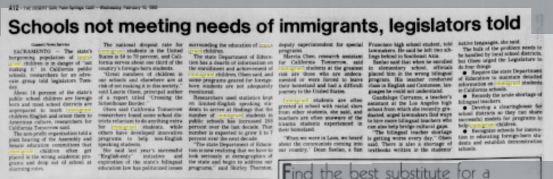
Desert Sun, February 10, 1988
Notes:
Teacher Notes: Here teachers might discuss the roles and responsibilities schools have with immigrant students. Depending on class demographics, teachers might highlight resources immigrant students have on campus.
Please note that these slides are samples of headlines. Teachers might explore immigration from a more local lens or pull additional headlines that demonstrate a wider variety of sentiment regarding the connotation of term immigrant through additional time periods or in specific areas in the US.

